Slide 1
Finance Fundamentals
Speaker’s name
Title
Not FDIC
Insured
May Lose Value
No Bank Guarantee
PPT402 330055 11/22R2
Notes:
Thank you for your time today! We are excited to be here to discuss the basic of Investing. It is our hope that this information will set you up to successfully achieve your future goals, whatever they may be!

Slide 2
Agenda
[01]
What is investing?
[02]
History
[03]
Fundamental principles
[04]
Next steps
PPT402 330055 11/22R2
2
Notes:
Today we will cover four topics:
What is investing?
History
Fundamental principles
Next steps

Slide 3
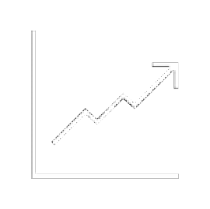
Investing is part of budgeting and consumer finance
FIRST THINGS FIRST
SAVE
Emergency fund Savings accounts
COVER FIXED EXPENSES
Bills
Taxes
COVER VARIABLE EXPENSES
Lifestyle
Groceries
INVEST
Assets Endeavors
PPT402 330055 11/22R2
3
Notes:
But, first things first.
Before you can invest your money, it is important to save a portion for emergencies, make sure your fixed expenses are covered each month, and you have money on hand or variable expenses like groceries, etc.
Once all of those items are accounted for in your budget, what is left can be allocated to your future goals and investments can be the vehicles that help you achieve them.

Slide 4
I wish I had waited longer before I invested.
— No One Ever
PPT402 330055 11/22R2
4
Notes:
Remember, no one has ever said, “I wish I would have waited longer before investing.” Having time on your side is extremely helpful as you invest as it can help you compound your returns.

Slide 5
01
What is investing?
PPT402 330055 11/22R2
5
Notes:
So exactly what is investing? Let’s dive in to discuss this further.

Slide 6
Definitions
What is investing?
The act of allocating resources, usually money, with the expectation of generating an income or profit
Personal to everyone
Intended for long-term goals
What is investing not?
Not a get-rich-quick scheme
Not one-size-fits all
Not a guarantee of a profit
Source: https://www.investopedia.com/terms/i/investing.asp
PPT402 330055 11/22R2
6
Notes:
According to Investopedia, investing is “the act of allocating resources, usually money, with the expectation of generating an income or profit” and it is personal to everyone. In order to invest you must formulate your goals and be committed to the long term. This is not a get rich quick scheme or a guarantee of profit.

Slide 7
Five things that affect the value of your money
What is investing?
%
IMPACT OF TAXES
HEALTH CARE
INFLATION
LOW INTEREST RATES
PROCRASTINATION
PPT402 330055 11/22R2
7
Notes:
As you invest, it is important to think about the five things that affect the value of your money:
Taxes
Healthcare
Inflation
Interest rates
Procrastination

Slide 8
The eighth wonder of the world: the power of compounding
What is investing?
VALUE
TIME
Initial investment
Investment earnings
PPT402 330055 11/22R2
8
Notes:
And never forget the eight wonder of the world: The power of compounding.

Slide 9
The beginner’s guide to bonds and stocks
What is investing?
Bonds — Debt instruments Stocks — Equity instruments
Debts of corporations, governments, Or other organizations. A type of loan,
borrowed from investors to raise funds for the issuing entity
Individuals can purchase shares of stock, Which represents ownership, or equity, of a fraction of a company. Companies raise capital for various reasons.
“Par value,” or face value: initial price
Company share price: reflects the present value of a corporation’s future cash flows and profits
Capital appreciation: a rise in an investment's market price, or the difference between the purchase price and the
selling price
“Coupon,” or interest rate:
a predetermined percentage the issuer promises to pay in regular increments throughout the term
Maturity date: the date the debtor must pay back the par value and any outstanding interest
Dividend: a recurring payment a company provides shareholders for owning a share of stock
PPT402 330055 11/22R2
9
Notes:
So you may be wondering… what types of investments are available? They can generally be split into two groups: stocks and bonds.Bonds are Debts of corporations, governments, or other organizations. A type of loan, borrowed from investors to raise funds for the issuing entity Stocks represents ownership, or equity, of a fraction of a company. Companies raise capital for various reasons

Slide 10
What can you invest in?
What is investing?
Intangible assets
Bonds
Stocks Copyrights
Individual
Brands
Tangible assets
Corporate Government
Mutual funds/ETFs
Real estate
Collectibles
Domestic
Residential
Art
Global
Land
Equipment
Small cap
Commercial
Inventory
Large cap
Not indicative of the entire investment universe.
PPT402 330055 11/22R2
10
Notes:
To take a deeper look at what you can invest in, this flow chart shows specific investment vehicles to consider.

Slide 11
02
History
PPT402 330055 11/22R2
11
Notes:
Now that we have discussed what investing is, let’s look back at the history of the markets.

Slide 12
The birth of stock exchanges dates to 1300
History
1600s
European governments invest in East Indian companies making long sea voyages
1300s
Venetian moneylenders sell debt issues
1773
London Stock Exchange is officially formed
1971
Trading begins on the NASDAQ exchange
1300
1600
1700
1800
1900
2022
1790
The first U.S. stock exchange opens: Philadelphia Stock Exchange
1923
The early version of the S&P 500 is created and begins tracking 90 stocks
PPT402 330055 11/22R2
12
Notes:
First, the birth of stock markets which happened as early as the 1300s when Venetian money lenders sold debt issues. Fast forward to today we have many stock exchanges such as The London Stock Exchange, Philadelphia Stock Exchange, S&P 500, NASDAQ.

Slide 13
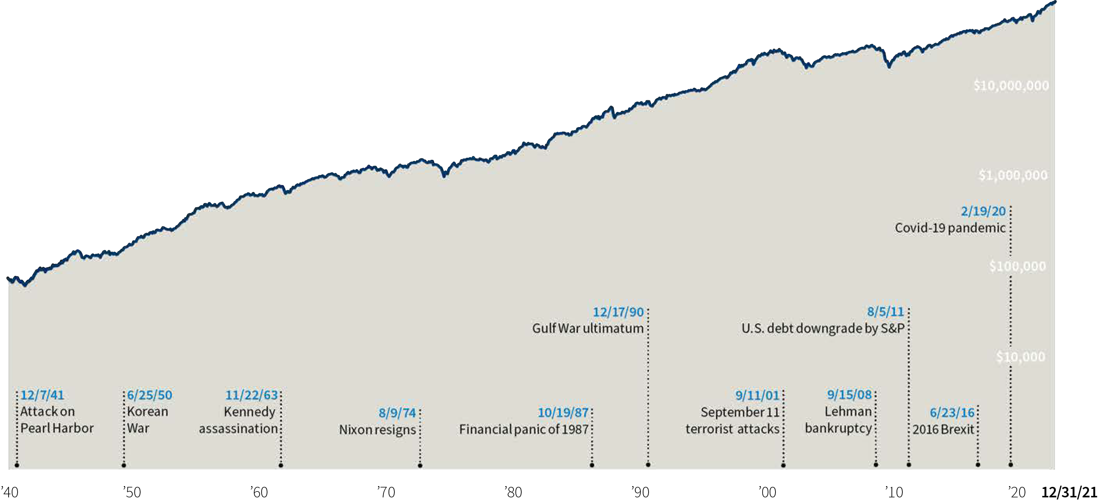
Markets often climb a mountain of worries
History
Historic stock market drops
PPT402 330055 11/22R2
13
Notes:
But as we look back, its important to remember that it is not all fun and games.
All too often, a crisis can lead to fear as public perceptions become overly pessimistic. Financial markets that are usually rational can behave irrationally. But the U.S. stock market has proven remarkably resilient; it historically has recovered from short term crisis events to move higher over longer time periods. The graph below shows a hypothetical investment in the S&P 500® Index, which represents some of the largest companies in the U.S. stock market from across all sectors of the economy. In spite of recessions, wars, and other crises, the annualized return over the past 80 years was 11.67%.
By staying invested during crises — or by investing during a crisis to take advantage of stock market valuations — investors can keep their portfolios on track in pursuit of their long-term goals.

Slide 14
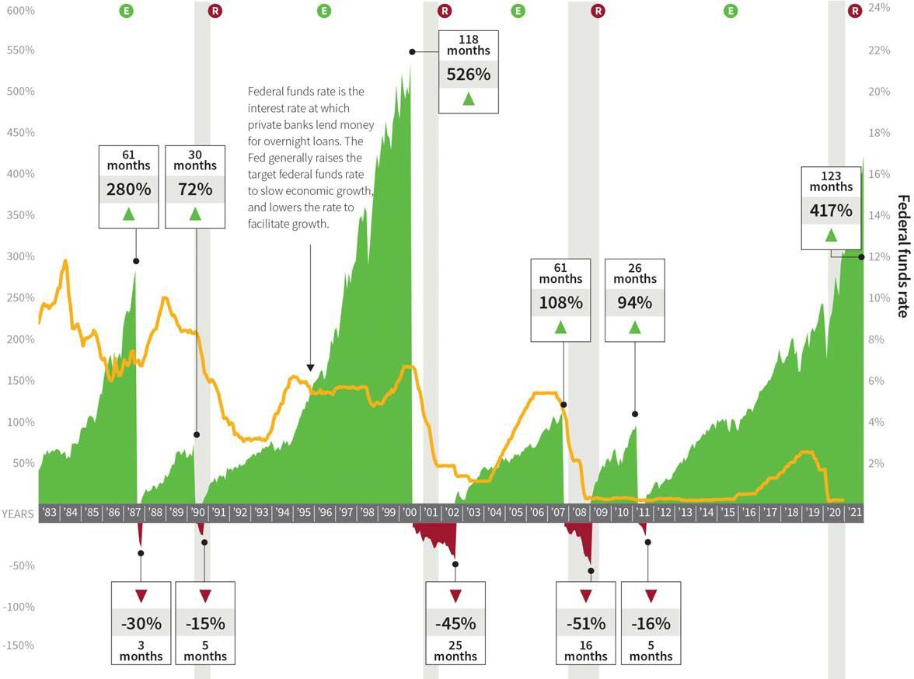
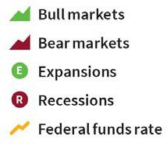
Bear markets interrupt bull markets
History
PPT402 330055 11/22R2
14
Notes:
To pursue the greater return potential of stocks, it makes more sense to stay committed to an investment plan rather than try to guess the best time to be in the market. Over the past 73 years, bull markets have lasted longer (50 months on average) than bear markets (13 months on average. Bull markets have begun during economic recessions and expansions and at all levels of rates. And while it is impossible to predict when a bull market will begin, it is possible to miss one by waiting on the sidelines.

Slide 15
Three key lessons from history
History
[01]
[02]
[03]
The unexpected can and will occur
Markets are cyclical
Historically, markets recover
PPT402 330055 11/22R2
15
Notes:
Overall, three key lessons we have learned from history is:
The unexpected can and will occur
Markets are cyclical
Historically, markets recover

Slide 16
03
Fundamental principles
PPT402 330055 11/22R2
16
Notes:
Next, let’s discuss fundamental principles.

Slide 17
Create goals for your money
Fundamental principles
What for?
How long?
How much?
What’s next?
PPT402 330055 11/22R2
17
Notes:
The first one is to create goals for your money. To create goals you can ask yourself:
What for?
How long?
How much?
What’s next?

Slide 18
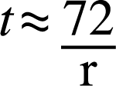
Invest early in life
Fundamental principles
Capitalize on growth potential and the power of time
Use the Rule of 72 to your advantage
Age 23
Age 32
Age 65
INVESTOR
$5,500 per year | $5,500 per year
Invests for only 10 years $55,000 invested
 | Invests for 34 years $187,000 invested
$5,500 per year
Invests for 43 years $236,500 invested
Balance at retirement
$1,009,978
INVESTOR
B
$872,447
INVESTOR
C
$1,812,707
This example assumes beginning of year investments that earn an 8% annual rate of return. This illustration is intended solely to demonstrate the comparative effect of compounding on current versus delayed investments. It does not reflect the actual return on investment, which will fluctuate with market conditions. Regular investing does not guarantee a profit or protect against loss in declining markets. Withdrawals from an IRA may be subject to income taxes and certain penalties. All funds involve risk, including the loss of principal.
PPT402 330055 11/22R2
18
Notes:
Start saving early and stick with your plan. It’s a time-tested strategy for investors seeking to build wealth. A head start of just a few years can make a big difference, thanks to the power of compounding returns. Staying invested can offer even more growth potential.

Slide 19
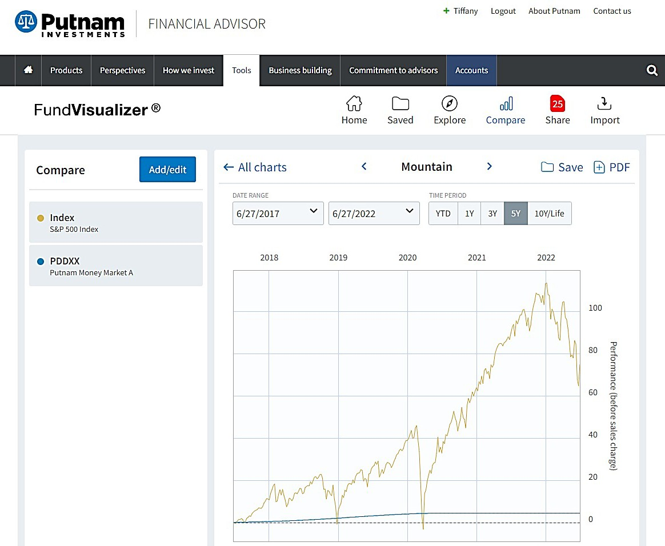
Understand saving versus investing
Fundamental principles
Prioritize an emergency fund
Choose the most effective investment vehicle for your goals
PPT402 330055 11/22R2
19
Notes:
It is also important to understand saving versus investing. Remember to Prioritize an emergency fund and choose the most effective investment vehicle for your goals

Slide 20
Know your risk tolerance
Fundamental principles
Learn the risks associated with different investments
Assess your risk comfort levels and determine the type of investor you are
Types of investors
Bonds Stocks
20%
30%
40%
70%
60%
80%
CONSERVATIVE
MODERATE
AGGRESSIVE
PPT402 330055 11/22R2
20
Notes:
Take time to know your risk tolerance. This can inform the types of investments you select to arrive at your goals. To help, you can:
Learn the risks associated with different investments
Assess your risk comfort levels and determine the type of investor you are

Slide 21
Reduce risk as you get close to your goals
Fundamental principles
100%
90%
80%
Stock/bond allocation
Bonds
70%
60%
50%
40%
Stocks
Return
30%
20%
10%
Risk
0%
35
30
25
20
Years to goals
15
10
5
0
Risk/return trade-off
Allocation glide path
Concepts shown here are simplified and not to scale.
PPT402 330055 11/22R2
21
Notes:
As you approach your goals, consider adjusting your risk levels to stay on track.

Slide 22
Stay invested
Fundamental principles
Take advantage of time, not timing
Be disciplined and don’t miss the market’s best days
$10,000 invested in the S&P 500 (12/31/06–12/31/21)
Stayed fully invested 10.66% annualized total return |  |  |  |  | $45,682
Missed 10 best days 5.05% |  |  |  | $20,929
Missed 20 best days 1.59% |  |  | $12,671
Missed 30 best days –1.18% |  | $8,365
Missed 40 best days –3.58% | $5,786
$0
$10,000
$20,000
$30,000
$40,000
$50,000
Data is historical. Past performance is not a guarantee of future results. The best time to invest assumes shares are bought when market prices are low.
PPT402 330055 11/22R2
22
Notes:
Investors who stay the course can benefit.
A $10,000 investment in the S&P 500 Index in 2001 would have grown to $61,685 by December 31, 2021, despite the 51% downturn of 2008–2009. Please keep in mind that returns for other periods may have been less favorable and that other market segments may not have recovered from this downturn.

Slide 23
Fundamental principles
Diversify your portfolio
2002 | 2003 | 2004 | 2005 | 2006 | 2007 | 2008 | 2009 | 2010 | 2011 | 2012 | 2013 | 2014 | 2015 | 2016 | 2017 | 2018 | 2019 | 2020 | 2021
AGG | SCG | SCV | IE | IE | LCG | AGG | Converts | SCG | AGG | SCV | SCG | LCC | LCG | SCV | LCG | Cash | LCG | Converts | LCC
10.25% | 48.54% | 22.25% | 13.54% | 26.34% | 11.81% | 5.24% | 49.13% | 29.09% | 7.84% | 18.05% | 43.30% | 13.69% | 5.67% | 31.74% | 30.21% | 1.87% | 36.39% | 46.22% | 28.71%
Cash | SCV | IE | MCC | SCV | IE | Cash | MCC | MCC | LCG | LCV | MCC | LCV | LCC | LCV | IE | Converts | LCC | LCG | SCV
1.78% | 46.03% | 20.25% | 12.65% | 23.48% | 11.17% | 2.06% | 40.48% | 25.48% | 2.64% | 17.51% | 34.76% | 13.45% | 1.38% | 17.34% | 25.03% | 0.15% | 31.49% | 38.49% | 28.27%
Converts | MCC | MCC | LCV | LCV | SCG | SCV | LCG | SCV | LCC | IE | SCV | MCC | AGG | MCC | SCG | AGG | MCC | SCG | LCG
–8.58% | 40.06% | 20.22% | 7.05% | 22.25% | 7.05% | –28.92% | 37.21% | 24.50% | 2.11% | 17.32% | 34.52% | 13.22% | 0.55% | 13.80% | 22.17% | 0.01% | 30.54% | 34.63% | 27.60%
SCV | IE | LCV | LCG | LCC | AGG | Converts | SCG | Converts | LCV | MCC | LCG | LCG | Cash | LCC | LCC | LCG | SCG | LCC | LCV
–11.43% | 38.59% | 16.49% | 5.26% | 15.79% | 6.97% | –35.73% | 34.47% | 16.77% | 0.39% | 17.28% | 33.48% | 13.05% | 0.05% | 11.96% | 21.83% | –1.51% | 28.48% | 18.40% | 25.16%
LCV | LCV | SCG | LCC | MCC | MCC | LCV | IE | LCG | Cash | LCC | LCV | Converts | IE | SCG | MCC | LCC | LCV | MCC | MCC
–15.52% | 30.03% | 14.31% | 4.91% | 15.26% | 5.60% | –36.85% | 31.78% | 16.71% | 0.10% | 16.00% | 32.53% | 9.44% | –0.81% | 11.32% | 18.52% | –4.38% | 26.54% | 17.10% | 22.58%
IE | LCG | LCC | SCV | SCG | LCC | LCC | LCC | LCV | MCC | LCG | LCC | AGG | SCG | Converts | Converts | LCV | Converts | IE | IE
–15.94% | 29.75% | 10.88% | 4.71% | 13.35% | 5.49% | –37.00% | 26.46% | 15.51% | –1.55% | 15.26% | 32.39% | 5.97% | –1.38% | 10.43% | 13.70% | –8.27% | 23.15% | 7.82% | 11.26%
MCC | LCC | Converts | SCG | Converts | Cash | LCG | SCV | LCC | SCG | Converts | Converts | SCG | MCC | LCG | LCV | MCC | SCV | AGG | Converts
–16.19% | 28.68% | 9.61% | 4.15% | 12.83% | 5.00% | –38.44% | 20.58% | 15.06% | –2.91% | 14.96% | 24.92% | 5.60% | –2.44% | 7.08% | 13.66% | –9.06% | 22.39% | 7.51% | 6.34%
LCC | Converts | LCG | Cash | LCG | Converts | SCG | LCV | IE | Converts | SCG | IE | SCV | Converts | AGG | SCV | SCG | IE | SCV | SCG
–22.10% | 27.15% | 6.30% | 3.07% | 9.07% | 4.53% | –38.54% | 19.69% | 7.75% | –5.18% | 14.59% | 22.78% | 4.22% | –2.99% | 2.65% | 7.84% | –9.31% | 22.01% | 4.63% | 2.83%
LCG | AGG | AGG | AGG | Cash | LCV | MCC | AGG | AGG | SCV | AGG | Cash | Cash | LCV | IE | AGG | SCV | AGG | LCV | Cash
–27.88% | 4.10% | 4.34% | 2.43% | 4.85% | –0.17% | –41.46% | 5.93% | 6.54% | –5.50% | 4.22% | 0.07% | 0.03% | –3.83% | 1.00% | 3.54% | –12.86% | 8.72% | 2.80% | 0.05%
SCG | Cash | Cash | Converts | AGG | SCV | IE | Cash | Cash | IE | Cash | AGG | IE | SCV | Cash | Cash | IE | Cash | Cash | AGG
–30.26% | 1.15% | 1.33% | 1.01% | 4.33% | –9.78% | –43.38% | 0.21% | 0.13% | –12.14% | 0.11% | –2.02% | –4.90% | –7.47% | 0.33% | 0.86% | –13.79% | 2.28% | 0.67% | –1.54%
Large-Cap Growth Equities (LCG) are represented by the Russell 1000® Growth Index, which is an unmanaged index of those companies in the large-cap Russell 1000® Index chosen for their growth orientation.
Small-Cap Growth Equities (SCG) are represented by the Russell 2000® Growth Index, which is an unmanaged index of those companies in the small-cap Russell 2000® Index chosen for their growth orientation.
Large-Cap Value Equities (LCV) are represented by the Russell 1000® Value Index, which is an unmanaged index of those companies in the large-cap Russell 1000® Index chosen for their value orientation.
Small-Cap Value Equities (SCV) are represented by the Russell 2000® Value Index, which is an unmanaged index of those companies in the small-cap Russell 2000® Index chosen for their value orientation.
Large-Cap Core Equities (LCC) are represented by the S&P 500® Index, which is an unmanaged index of common stock performance.
Mid-Cap Core Equities (MCC) are represented by the Russell Midcap® Index, which is an unmanaged index that measures the performance of the 800 smallest companies in the Russell 1000® Index.
Convertible securities (Converts) are represented by the ICE BofA
U.S. Convertible Index, which tracks the performance of publicly issued
U.S. dollar-denominated convertible securities of U.S. companies.
Data is historical. Past performance is not a guarantee of future results. It is not possible to invest directly in an index.
International equities (IE) are represented by the MSCI EAFE Index (ND), which is an unmanaged index of equity securities from developed countries in Western Europe, the Far East, and Australasia.
U.S. bonds (AGG) are represented by the Bloomberg U.S. Aggregate Bond Index, which is an unmanaged index of U.S. investment-grade fixed income securities.
Cash is represented by the ICE BofA U.S. 3-month T-Bill Index, which is an unmanaged index used as a general measure for money market or cash instruments.
PPT402 330055 11/22R2
23
Notes:
And always diversity your portfolio since leaders in one year could be losers the next year.
Over time, diversifying across asset classes can help manage risk and potentially boost returns. As shown in the asset allocation chart on the right, diversifying a portfolio has outperformed chasing the leading or the lagging asset classes over the past 14 years.

Slide 24
Next steps
04
PPT402 330055 11/22R2
24
Notes:
So what are the next steps?

Slide 25
Buyer beware
Next steps
No guarantees
Not always insured by the Federal Deposit Insurance Corporation (FDIC)
Be wary of promotions for the “best” or “no risk” investments
Be careful who you take advice from
PPT402 330055 11/22R2
25
Notes:
Buyer beware
No guarantees
Not always insured by the Federal Deposit Insurance Corporation (FDIC)
Be wary of promotions for the “best” or “no risk” investments
Be careful who you take advice from

Slide 26
Key takeaways and action items
Next steps
Understand saving versus investing
Start early, stay invested, and be consistent
Systematic investment accounts
Keep learning
Markets in Minutes podcast
Research market commentary from industry professionals
Investing is a lifelong learning process
Consider working with a professional
Stay connected to your family advisor
PPT402 330055 11/22R2
26
Notes:
We encourage you to write down these action steps:
Understand saving versus investing
Remember that investing is a lifelong learning process
Consider working with a professional
As always, we appreciate your time and attention today! Thank you!

Slide 27
All investments involve risk, including the loss of principal.
This material is for informational and educational purposes only. It is not a recommendation of any specific investment product, strategy, or decision, and is not intended to suggest taking or refraining from any course of action. It is not intended to address the needs, circumstances, and objectives of any specific investor. This information is not meant as tax or legal advice. Investors should consult a professional advisor before making investment and financial decisions and for more information on tax rules and other laws, which are complex and subject to change.
Investors should carefully consider the investment objectives, risks, charges, and expenses of a fund before investing. For a prospectus, or a summary prospectus if available, containing this and other information for any Putnam fund or product, call your financial representative or call Putnam at 1-800-225-1581.
Please read the prospectus carefully before investing.
Putnam Retail Management putnam.com
PPT402 330055 11/22R2
27
Notes:
It is important to note that all investments involve risk, including the loss of principal. This material is for informational and educational purposes only and investors should carefully consider the investment objectives, risks, charges, and expenses of a fund before investing.

